Slide 1
Module-2 : Parallel Programming
Dr.A.Srinivas
PES Institute of Technology
Bangalore, India
a.srinivas@pes.edu

Slide 2
Major Forms of Decomposition

Slide 3
Concurrency (TBC)
How different tasks can be concurrently carried out.

Slide 4
Concurrency: Very much in Real World Steps in cooking a pasta meal

Slide 5
Flynn’s Taxanomy

Slide 6
Single Instruction Single Data (SISD) :
- Only one Data Stream is processed by the CPU during a given clock cycle.
Multiple Instruction Single Data (MISD)
- Processing of Single Data with Multiple Instructions
Single Instruction Multiple Data (SIMD) :
Multiple Data Elements are processed in a single clock cycle(Intel MMX, SSE, SSE2, SSE3
Multiple Instruction Single Data (MIMD) : Can execute multiple instruction streams, while working on a separate and independent Data Stream

Slide 7
Granularity of Concurrency
Intra-instruction (Pipelining)
Parallel instructions (SIMD, VLIW)
Tight-coupled MP
Loosely-coupled MP

Slide 8
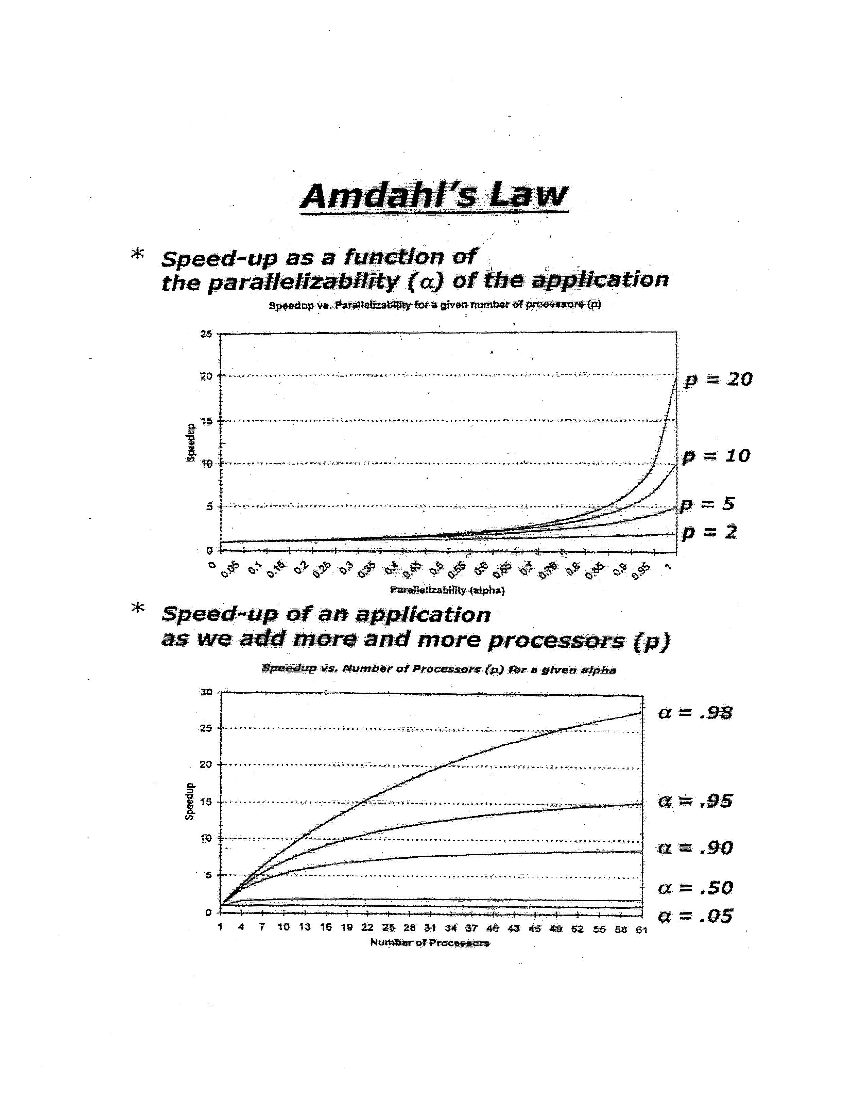

Slide 9
Metrics
Speed-up:
Efficiency:
Utilization:
Redundancy:

Slide 10
Threads

Slide 12
Flow of Threads

Slide 13
Java Threads
A thread is not an object
A thread is a flow of control
A thread is a series of executed statements
A thread is a nested sequence of method calls

Slide 14
Illustration of a Thread
Thread : Basic Unit of CPU Utilization
- thread contains a PC pointing to the current instructions.
- thread contains :
- CPU state information for the current
thread, other resources such as stack etc.
I

Slide 15
Relationships among Processors, Processes and Threads

Slide 16
Mapping Models of Threads to Processes

Slide 18
The Thread Object
A thread is not an object
A Thread is an object
void start()
Creates a new thread and makes it runnable
void run()
The new thread begins its life inside this method

Slide 19
Thread Creation Diagram
Object A
Object BThread (extends Thread)
Thread t = new BThread();
t.start();
doMoreStuff();
BThread() {
}
void start() {
// create thread
}
void run() {
doSomething();
}

Slide 20
Thread Creation Diagram
Object A
Object BThread (extends Thread)
Thread t = new BThread();
t.start();
doMoreStuff();
BThread() {
}
void start() {
// create thread
}
void run() {
doSomething();
}

Slide 21
Thread Creation Diagram
Object A
Object BThread (extends Thread)
Thread t = new BThread();
t.start();
doMoreStuff();
BThread() {
}
void start() {
// create thread
}
void run() {
doSomething();
}

Slide 22
Thread Creation Diagram
Object A
Object BThread (extends Thread)
Thread t = new BThread();
t.start();
doMoreStuff();
BThread() {
}
void start() {
// create thread
}
void run() {
doSomething();
}

Slide 23
Thread Creation Diagram
Object A
Object BThread (extends Thread)
Thread t = new BThread();
t.start();
doMoreStuff();
BThread() {
}
void start() {
// create thread
}
void run() {
doSomething();
}

Slide 24
Thread Creation Diagram
Object A
Object BThread (extends Thread)
Thread t = new BThread();
t.start();
doMoreStuff();
BThread() {
}
void start() {
// create thread
}
void run() {
doSomething();
}

Slide 25
Thread Creation Diagram
Object A
Object BThread (extends Thread)
Thread t = new BThread();
t.start();
doMoreStuff();
BThread() {
}
void start() {
// create thread
}
void run() {
doSomething();
}

Slide 26
Thread Creation Diagram
Object A
Object BThread (extends Thread)
Thread t = new BThread();
t.start();
doMoreStuff();
BThread() {
}
void start() {
// create thread
}
void run() {
doSomething();
}

Slide 27
Thread Creation Diagram
Object A
Object BThread (extends Thread)
Thread t = new BThread();
t.start();
doMoreStuff();
BThread() {
}
void start() {
// create thread
}
void run() {
doSomething();
}

Slide 28
Runnable Interface
A helper to the thread object
The Thread object’s run() method calls the Runnable object’s run() method
Allows threads to run inside any object, regardless of inheritance

Slide 29
Runnable Example
Talker talker = new Talker();
Thread t = new Thread(talker);
t.Start();
---
class Talker implements Runnable {
public void run() {
while (true) {
System.out.println(“yakitty yak”);
}
}
}

Slide 30
Tread Lifecycle

Slide 31
Thread Lifecycle
Active
sleep(500)
Blocked
Born
wake up
JVM
start()
suspend()
Runnable
resume()
stop()
wait
stop()
notify
Dead
block on I/O
I/O available

Slide 32
Blocking Threads
When reading from a stream, if input is not available, the thread will block
Thread is suspended (“blocked”) until I/O is available
Allows other threads to automatically activate
When I/O available, thread wakes back up again
Becomes “runnable”
Not to be confused with the Runnable interface

Slide 33
Thread Scheduling
In general, the runnable thread with the highest priority is active (running)
Java is priority-preemptive
If a high-priority thread wakes up, and a low-priority thread is running
Then the high-priority thread gets to run immediately
Allows on-demand processing
Efficient use of CPU

Slide 34
Thread Starvation
If a high priority thread never blocks
Then all other threads will starve
Must be clever about thread priority

Slide 35
Thread Priorities: General Strategies
Threads that have more to do should get lower priority
Counterintuitive
Cut to head of line for short tasks
Give your I/O-bound threads high priority
Wake up, immediately process data, go back to waiting for I/O

Slide 36
Race Conditions
Two threads are simultaneously modifying a single object
Both threads “race” to store their value
In the end, the last one there “wins the race”
(Actually, both lose)

Slide 37
Race Condition Example
class Account {
int balance;
public void deposit(int val)
{
int newBal;
newBal = balance + val;
balance = newBal;
}
}

Slide 38
Synchronization

Slide 39
Thread Synchronization
Language keyword: synchronized
Takes out a monitor lock on an object
Exclusive lock for that thread
If lock is currently unavailable, thread will block

Slide 40
Thread Synchronization
Protects access to code, not to data
Make data members private
Synchronize accessor methods
Puts a “force field” around the locked object so no other threads can enter
Actually, it only blocks access to other synchronizing threads

Slide 41
Shared Data Synchronization

Slide 43
Recursive Lock

Slide 44
Thread Deadlock
If two threads are competing for more than one lock
Example: bank transfer between two accounts
Thread A has a lock on account 1 and wants to lock account 2
Thread B has a lock on account 2 and wants to lock account 1

Slide 45
Avoiding Deadlock
No universal solution
Ordered lock acquisition
Encapsulation (“forcing directionality”)
Spawn new threads
Check and back off
Timeout
Minimize or remove synchronization

Slide 46
Wait and Notify
Allows two threads to cooperate
Based on a single shared lock object

Slide 47
Wait and Notify: Code
Consumer:
synchronized (lock) {
while (!resourceAvailable()) {
lock.wait();
}
consumeResource();
}

Slide 48
Wait and Notify: Code
Producer:
produceResource();
synchronized (lock) {
lock.notifyAll();
}

Slide 49
Wait/Notify Sequence
Lock Object
1. synchronized(lock){
3. produceResource()
2. lock.wait();
4. synchronized(lock) {
9. consumeResource();
5. lock.notify();
10. }
6.}
7. Reacquire lock
8. Return from wait()
Consumer
Thread
Producer
Thread

Slide 50
Wait/Notify Sequence
Lock Object
1. synchronized(lock){
3. produceResource()
2. lock.wait();
4. synchronized(lock) {
9. consumeResource();
5. lock.notify();
10. }
6.}
7. Reacquire lock
8. Return from wait()
Consumer
Thread
Producer
Thread

Slide 51
Wait/Notify Sequence
Lock Object
1. synchronized(lock){
3. produceResource()
2. lock.wait();
4. synchronized(lock) {
9. consumeResource();
5. lock.notify();
10. }
6.}
7. Reacquire lock
8. Return from wait()
Consumer
Thread
Producer
Thread

Slide 52
Wait/Notify Sequence
Lock Object
1. synchronized(lock){
3. produceResource()
2. lock.wait();
4. synchronized(lock) {
9. consumeResource();
5. lock.notify();
10. }
6.}
7. Reacquire lock
8. Return from wait()
Consumer
Thread
Producer
Thread

Slide 53
Wait/Notify Sequence
Lock Object
1. synchronized(lock){
3. produceResource()
2. lock.wait();
4. synchronized(lock) {
9. consumeResource();
5. lock.notify();
10. }
6.}
7. Reacquire lock
8. Return from wait()
Consumer
Thread
Producer
Thread

Slide 54
Wait/Notify Sequence
Lock Object
1. synchronized(lock){
3. produceResource()
2. lock.wait();
4. synchronized(lock) {
9. consumeResource();
5. lock.notify();
10. }
6.}
7. Reacquire lock
8. Return from wait()
Consumer
Thread
Producer
Thread

Slide 55
Wait/Notify Sequence
Lock Object
1. synchronized(lock){
3. produceResource()
2. lock.wait();
4. synchronized(lock) {
9. consumeResource();
5. lock.notify();
10. }
6.}
7. Reacquire lock
8. Return from wait()
Consumer
Thread
Producer
Thread

Slide 56
Wait/Notify Sequence
Lock Object
1. synchronized(lock){
3. produceResource()
2. lock.wait();
4. synchronized(lock) {
9. consumeResource();
5. lock.notify();
10. }
6.}
7. Reacquire lock
8. Return from wait()
Consumer
Thread
Producer
Thread

Slide 57
Wait/Notify Sequence
Lock Object
1. synchronized(lock){
3. produceResource()
2. lock.wait();
4. synchronized(lock) {
9. consumeResource();
5. lock.notify();
10. }
6.}
7. Reacquire lock
8. Return from wait()
Consumer
Thread
Producer
Thread

Slide 58
Wait/Notify Sequence
Lock Object
1. synchronized(lock){
3. produceResource()
2. lock.wait();
4. synchronized(lock) {
9. consumeResource();
5. lock.notify();
10. }
6.}
7. Reacquire lock
8. Return from wait()
Consumer
Thread
Producer
Thread

Slide 59
Wait/Notify Sequence
Lock Object
1. synchronized(lock){
3. produceResource()
2. lock.wait();
4. synchronized(lock) {
9. consumeResource();
5. lock.notify();
10. }
6.}
7. Reacquire lock
8. Return from wait()
Consumer
Thread
Producer
Thread

Slide 60
Wait/Notify: Details
Often the lock object is the resource itself
Sometimes the lock object is the producer thread itself

Slide 61
Wait/Notify: Details
Must loop on wait(), in case another thread grabs the resource...
After you are notified
Before you acquire the lock and return from wait()
Use lock.notifyAll() if there may be more than one waiting thread

Slide 62
Wait/Notify Example: Blocking Queue
class BlockingQueue extends Queue {
public synchronized Object remove() {
while (isEmpty()) {
wait(); // really this.wait()
}
return super.remove();
}
public synchronized void add(Object o) {
super.add(o);
notifyAll(); // this.notifyAll()
}
}

Slide 63
Computer System Architectures
4 machine organizations
SISD - Single Instruction, Single Data
SIMD - Single Instruction, Multiple Data
MISD - Multiple Instruction, Single Data
MIMD - Multiple Instruction, Multiple Data

Slide 64
Flynn Architectures (1)
CU
I
PU
D
One data processed by CPU in a Clock Cycle
Serial Processor
SISD
D₁
PU₁
I
Array Processor
CU
D_{n}
PU_{n}
SIMD
CU – control unit
PU – processor unit
I – instruction stream
D – data stream
Multiple Data Elements processed in one clock cycle

Slide 65
Flynn Architectures (2)
I1
D₁
CU₁
PU₁
Can execute multiple instruction streams, while working on an independent datastream
Multiprocessor
and
Multicomputer
In
D_{n}
CU_{n}
PU_{n}
MIMD
I₁
CU₁
PU₁
No real examples
- possibly some pipeline architectures
D
Processing of multiple data by a single instruction
I_{n}
CU_{n}
PU_{n}
MISD

Slide 66
W
ith SIMD & MIMD machines of today, Software Developers can exploit Data Level & Task Level Parallelism.

